Slide 1

Data Transaction Using Hash Algorithm(SHA-256) In Blockchain
Presented By –
Md. Abu Raihan(1602016)
Md. Shahinur Islam(1602028)
Shamol Chandra Das(1602035)
Department of Computer Science & Engineering
Hajee Mohammad Danesh Science and Technology University (HSTU), Dinajpur-5200
March , 2020
1

Slide 2

CONTENTS
What is Blockchain?
Blockchain Architecture Component
Types of Blockchain
Transaction
Hash Algorithm (SHA-256)
Consensus Algorithm
Hash Tree
Advantages and Disadvantages
Conclusion
2

Slide 3
CONTENT COVERED
What is Blockchain?
Blockchain Architecture Component
Types of Blockchain
Transaction
Hash Algorithm (SHA-256)
Consensus Algorithm
Hash Tree
Advantages and Disadvantages
Conclusion
3

Slide 4
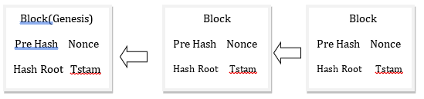
Blockchain
Distributed Ledger
Permanent
Secure
Chronological
4

Slide 5
CONTENT COVERED
Introduction
Blockchain Architecture Component
Types of Blockchain
Transaction
Hash Algorithm (SHA-256)
Consensus Algorithm
Hash Tree
Advantages and Disadvantages
Conclusion
5

Slide 6
Blockchain Architecture Component
Node
Transaction
Block
Chain
Miners
6

Slide 7
CONTENT COVERED
What is Blockchain?
Blockchain Architecture Component
Types of Blockchain
Block Transaction
Hash Algorithm (SHA-256)
Consensus Algorithm
Hash Tree
Advantages and Disadvantages
Conclusion
7

Slide 8
Types of Blockchain
Public Blockchain
Private Blockchain
Consortium Blockchain
8

Slide 9
CONTENT COVERED
What is Blockchain?
Blockchain Architecture Component
Types of Blockchain
Transaction
Hash Algorithm (SHA-256)
Consensus Algorithm
Hash Tree
Advantages and Disadvantages
Conclusion
9

Slide 10
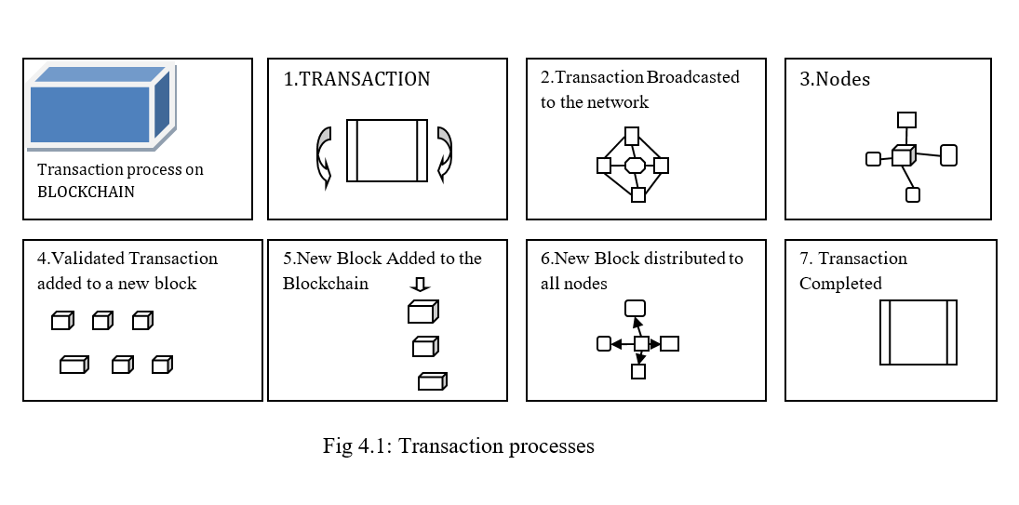
Transaction (1/2)
10
Notes:
Transaction request-broadcast transaction-validate transaction-add to blockchain

Slide 11
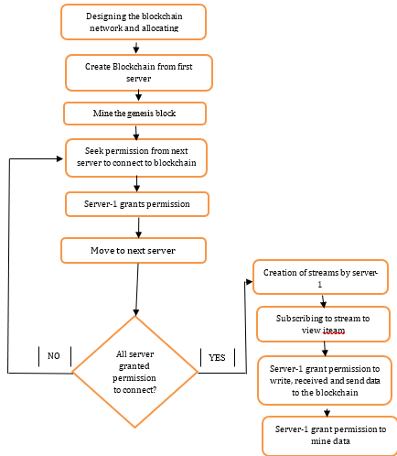
Transaction (2/2)
Work Flow:
11
Notes:
Network & Allocation, Create BlockServer, mine&genesis,permission,moveto next server,create stream server,write&read

Slide 12
CONTENT COVERED
What is Blockchain?
Blockchain Architecture Component
Types of Blockchain
Transaction
Hash Algorithm (SHA-256)
Consensus Algorithm
Hash Tree
Advantages and Disadvantages
Conclusion
12

Slide 13
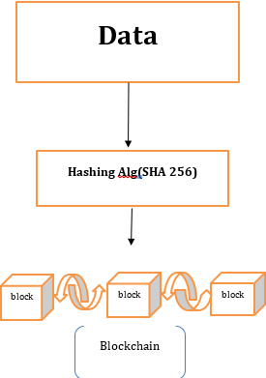
Hash Algorithm (SHA-256)
H^(i) = H^(i+1) + CM^(i)(H^(i+1))
where C is the SHA-256 compression function and + means word-wise mod 2^32 addition. H^(N) is the hash of M.
L+1+k = 448 mod 512
T1 >h + ∑1(e)+Ch(e,f,g)+Kj + Wj T2-> ∑n(a)+Maj(a,b,c) h ->g g ->f f ->e e ->d + T1 d ->c c ->b b-> a a ->T1 + T2
13

Slide 14
CONTENT COVERED
What is Blockchain?
Blockchain Architecture Component
Types of Blockchain
Transaction
Hash Algorithm (SHA-256)
Consensus Algorithm
Hash Tree
Advantages and Disadvantages
Conclusion
14

Slide 15
Consensus Algorithm (1/2)
Proof of work(PoW)
Proof of Stake(PoS)
Proof of Authority(PoA)
15
Notes:
1.Decentralized ladger,individual node (miners), process of maintaining (minig).
2.Validated before the network add in blockchain
3.Proof the owner.

Slide 16
Hash Function Properties(2/2)
Deterministic
Quick Computation
Pre-Image Resistance
A small change in input than changes the output
Collision Resistant
Puzzle Friendly
16

Slide 17
CONTENT COVERED
What is Blockchain?
Blockchain Architecture Component
Types of Blockchain
Transaction
Hash Algorithm (SHA-256)
Consensus Algorithm
Hash Tree
Advantages and Disadvantages
Conclusion
17

Slide 18
Hash Tree (1/2)
A Hash tree summarizes all the transaction in a block
Hash trees are created by repeatedly hashing pairs of nodes
Hash tree can significantly reduce the amount of data
18

Slide 19
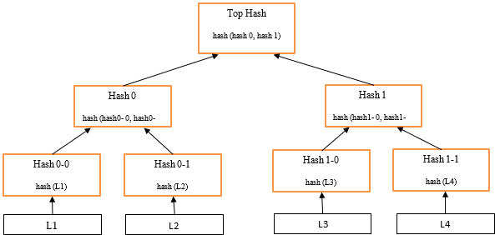
Hash Tree (2/2)
19

Slide 20
CONTENT COVERED
What is Blockchain?
Blockchain Architecture Component
Types of Blockchain
Transaction
Hash Algorithm (SHA-256)
Consensus Algorithm
Hash Tree
Anvantages And Disadvantages
Conclusion
20

Slide 21
Advantages (1/2)
Better Transparency
Reduced cost
True Traceability
No centralized control
Secure transaction
21

Slide 22
Disadvantages (2/2)
Data Modification
Private Key
Storge
22

Slide 23
CONTENT COVERED
What is Blockchain
Blockchain Architecture Component
Types of Blockchain
Transaction
Hash Algorithm (SHA-256)
Consensus Algorithm
Hash Tree
Advantages And Disadvantages
Conclusion
23

Slide 24
Conclusion
Blockchain is ledger operates in digital form, functions in real-time and can be viewed by anyone.
Future work are Blockchain in Cyber Security, Blockchain beyond the world of computing.
24

Slide 25

Thank you
25

